Slide 1

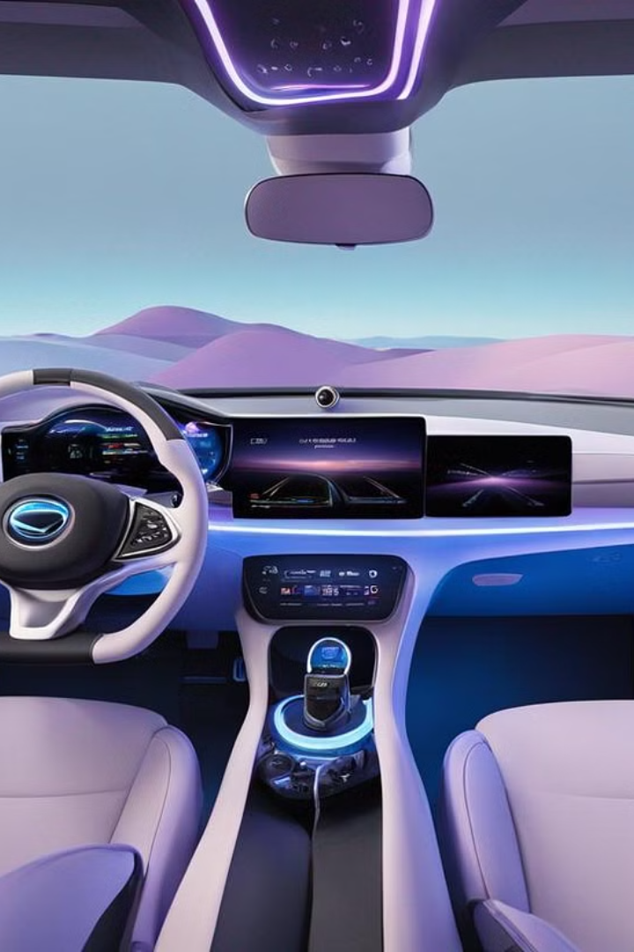




Design & Development of a Human-Agent Collaboration Model for Situation Awareness in Cockpit
by Yitong Hu

Slide 2

Table of Content
1
Background
2
My Solution: HCockpit & HCopilot
3
Design & Implementation
4
Demonstration
5
Conclusion and Future Work

Slide 3

Background
1
Autonomous Evolution
Evolutionary journey toward L5 autonomy
2
Oversight from Human
Necessity for human control
3
Human-Agent Collaboration
Enhancing driving experience and safty

Slide 4
Motivation
Improve UX
Improve Security
Driver perception enhancement
Complex tarffic conditions handling
Interactive cockpit functions
Low attention alerts
Autonomous preferences
Proactive threat alerts

Slide 5
My Solution:
HCockpit and HCopilot

Slide 6
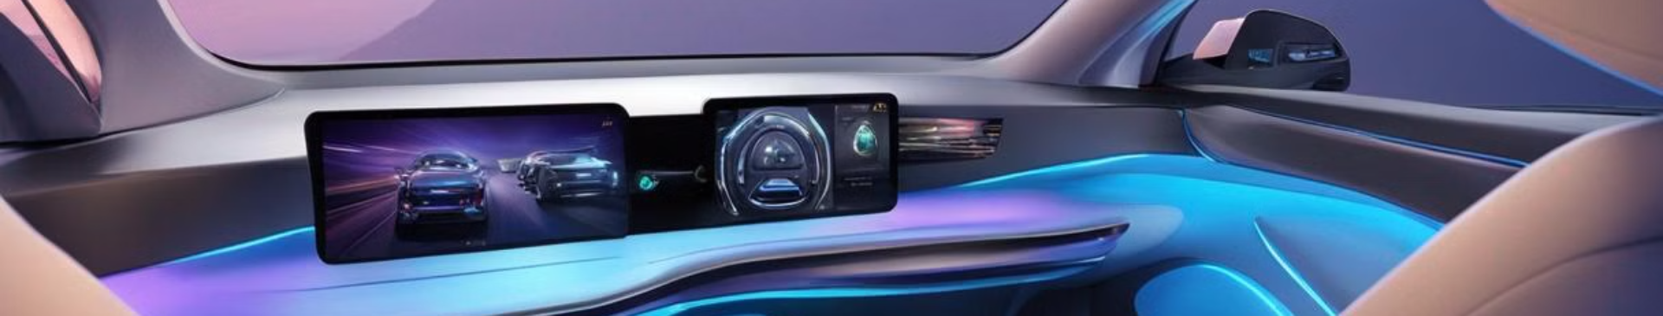
Design and Implementation
1
HCockpit Architecture
2
HCopilot Implementation

Slide 7
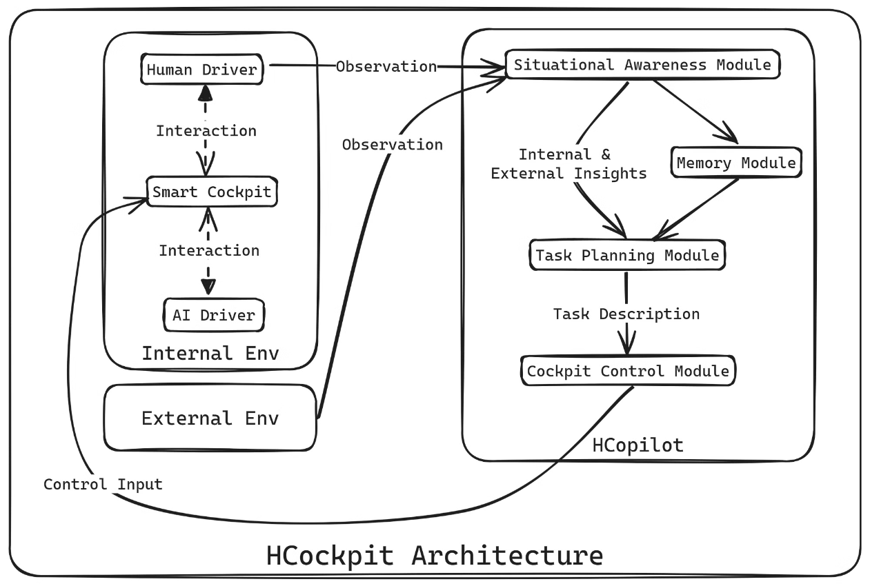
HCockpit Architecture

Slide 8

HCopilot Implementation
HCopilot is an agent developed following HCockpit architecture.

Slide 9
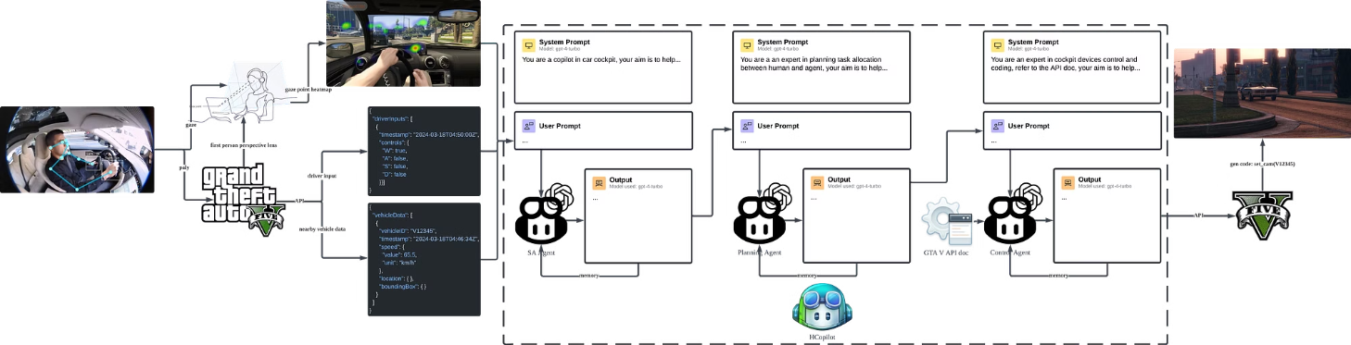
1. Pipeline

Slide 10
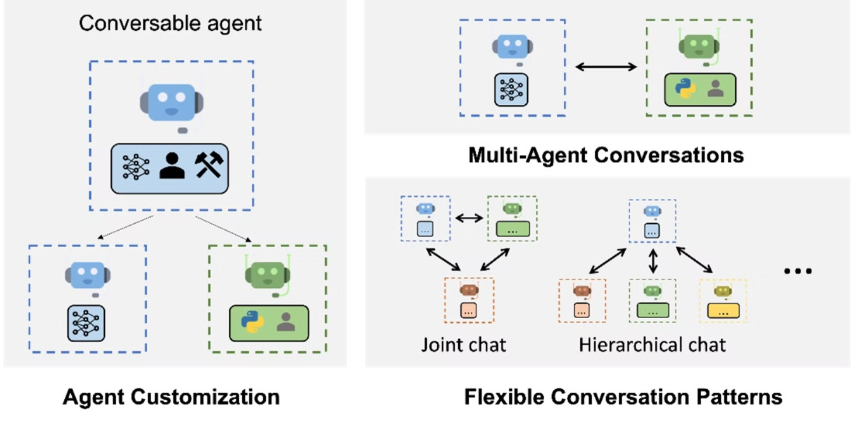
2. Multi-Agent System

Slide 11
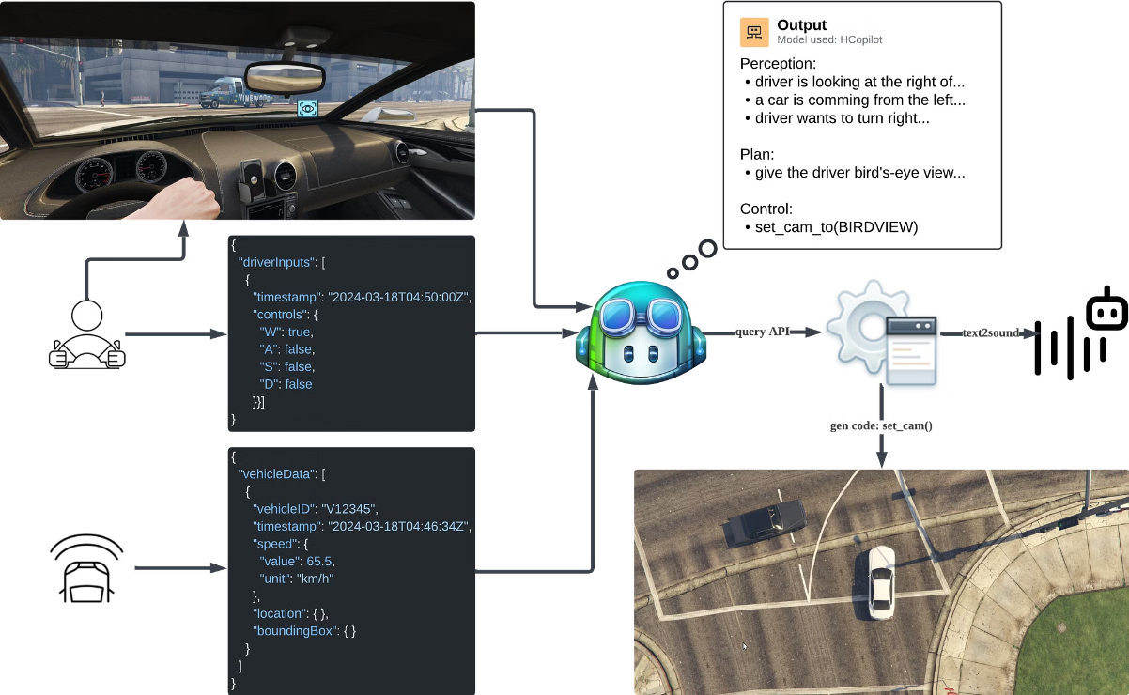
Demonstration
1. Driver Perception Enhancement Case: Trun Right

Slide 12
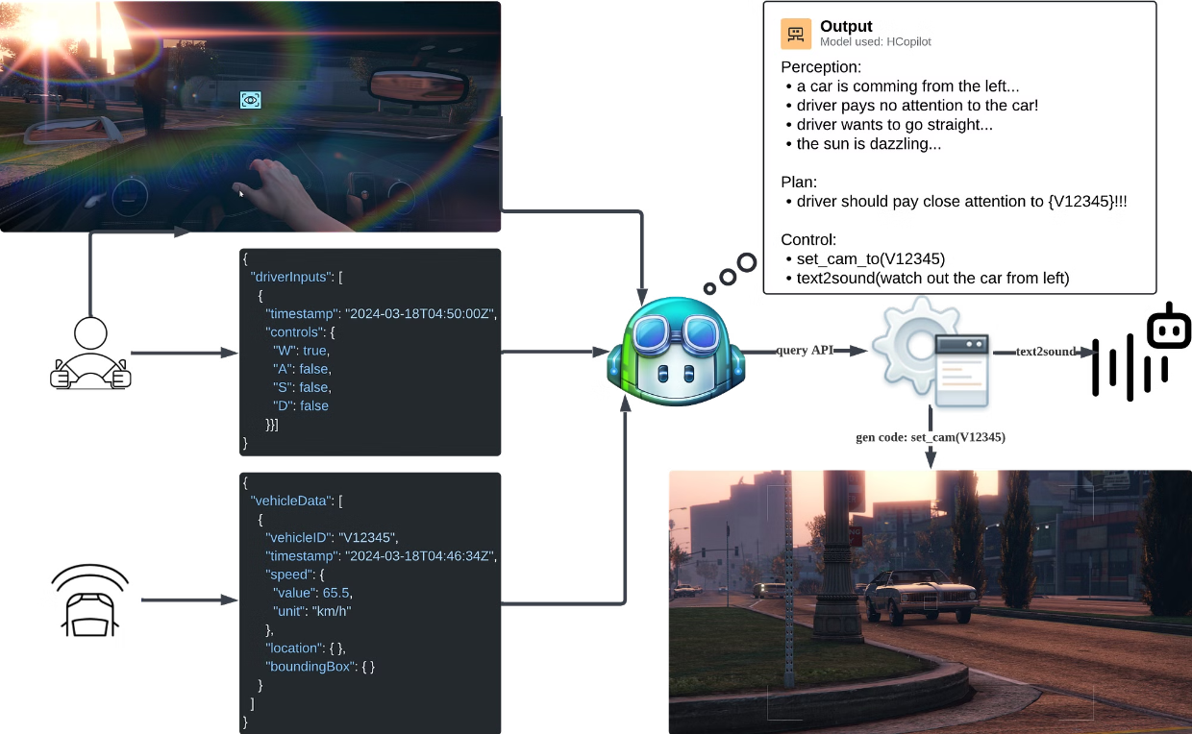
2. Proactive Threat Alerts Case: Too Bright to See

Slide 13
Conclusion and Future Work
Adapt and Integrate Machine Learning Models (undergoing)
Conduct Experiments
Develop a Demo
Test HCockpit in GTA V/CARLA
Demonstrate HCockpit’s capabilities on a variety of scenarios within the simulator
Adapt PaLI-X and PaLM-E
Adapt HCockpit to communicate with the simulator
Prompt-Tuning GPT-4 Turbo with Vision
Visualize HCockpit’s perception and decision-making process
Integrate OpenaAI CodeX/Google RT-2
Define key performance indicators (KPIs)

Slide 14

Thank You

